Slide 1
Let’s Code
By Subrahmanyam DEvarakonda

Slide 2
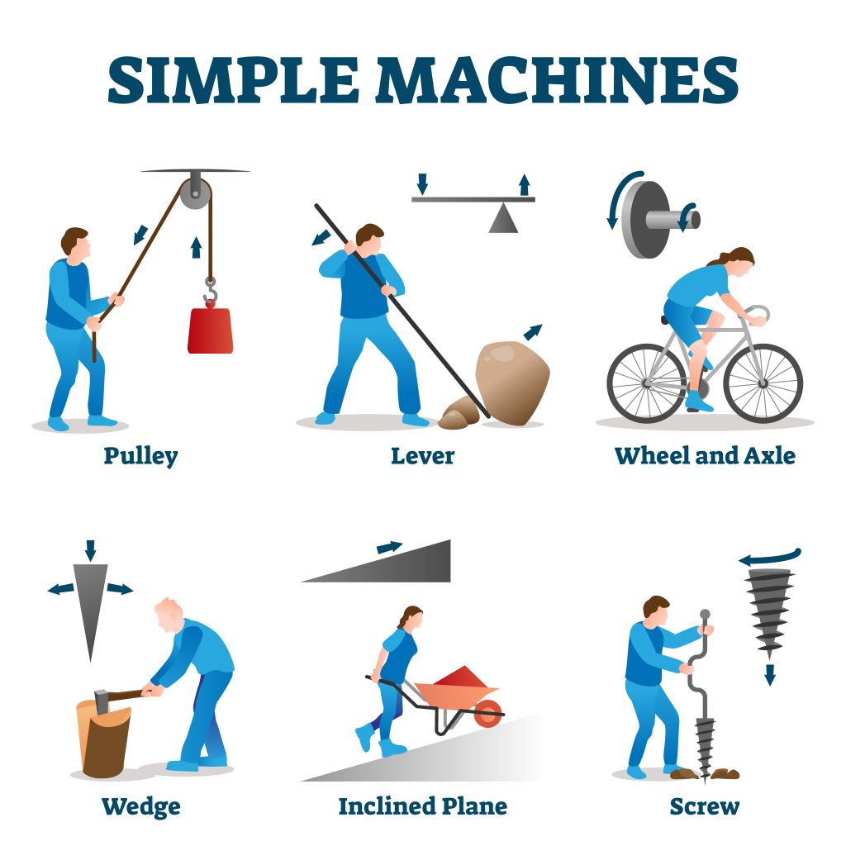
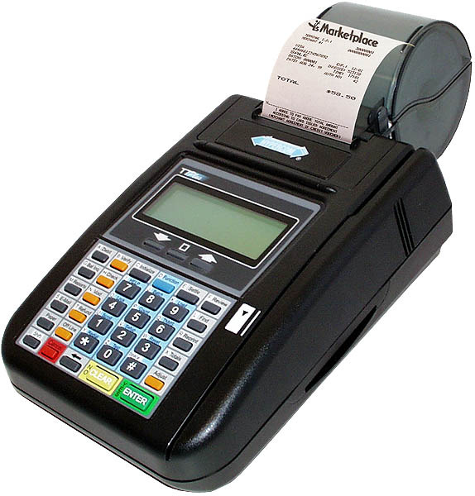
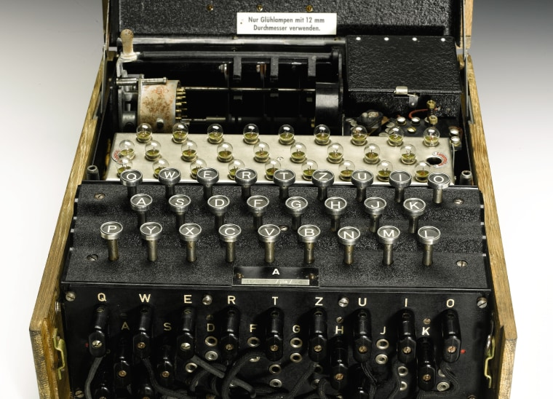
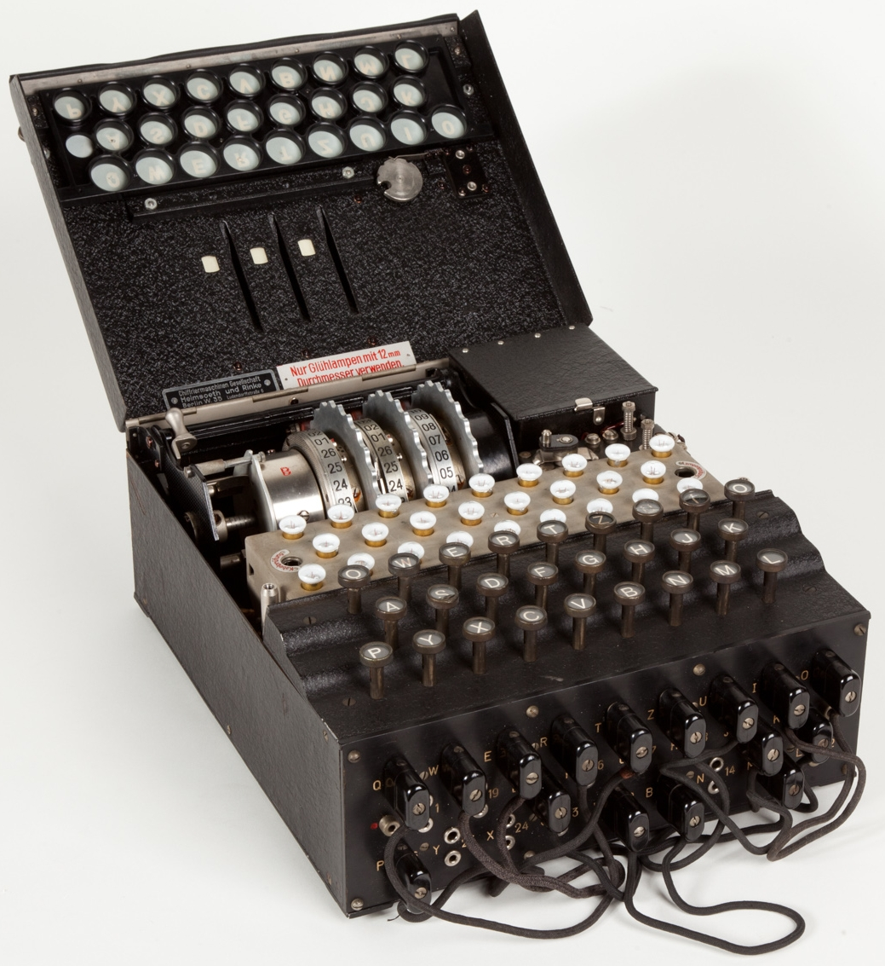
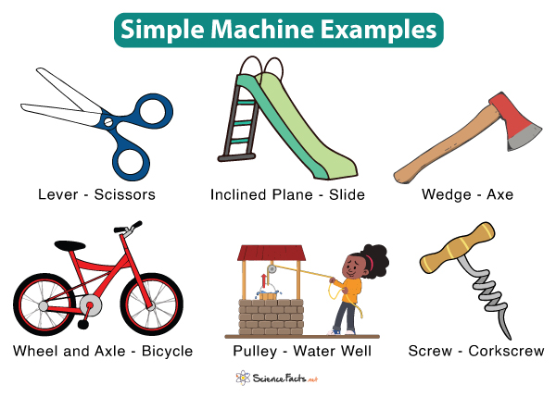
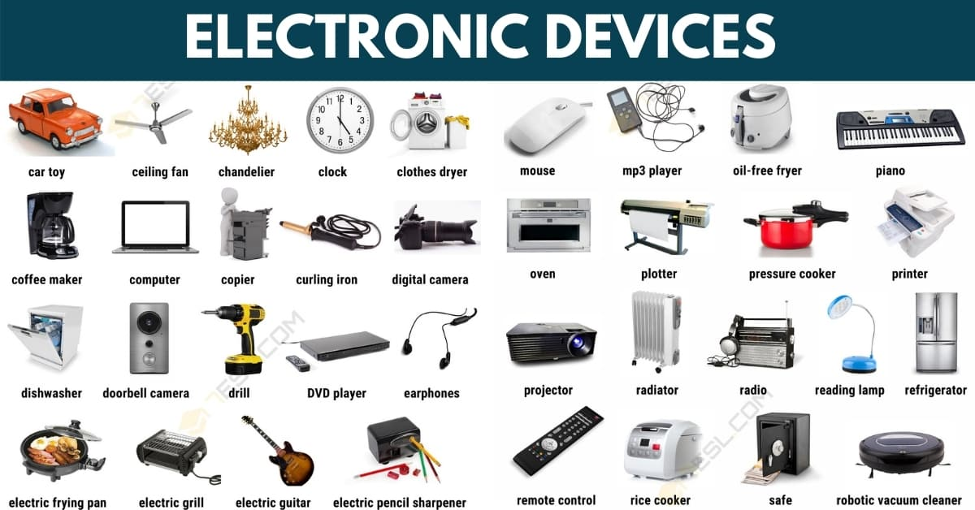
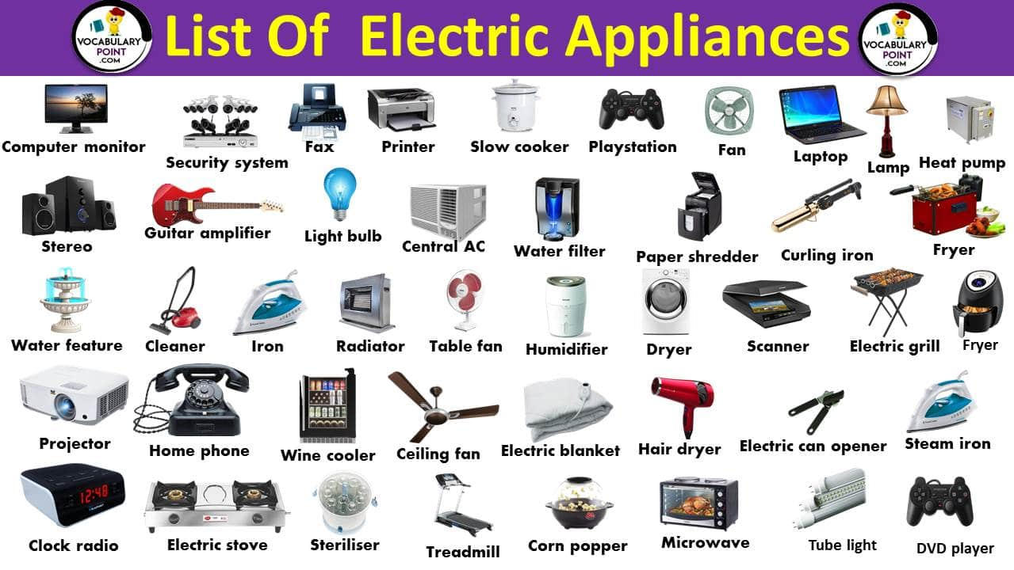
It’s a machine everywhere
Notes:
A simple machine is a machine that can do work in a single movement. Many machines are called compound machines since they are a combination of two or more simple machines.
Machines have been designed and devised to ease human effort and repetitively do the same job again and again.
Some machines are as simple as a pully that’s used to draw water from a well and complex enough to fly us from a source to a destination
Some machines are used convert a provided electrical energy to mechanical and vice-versa
Some of the machines known and among us in daily use are a calculator, mobile phone, ceiling fan, air-conditioner and the list goes on.
One of such early calculating machines were ENIGMA - The Enigma machine is a cipher device developed and used in the early- to mid-20th century to protect commercial, diplomatic, and military communication. It was employed extensively by Nazi Germany during World War II, in all branches of the German military. The Enigma machine was considered so secure that it was used to encipher the most top-secret messages.
https://en.wikipedia.org/wiki/Enigma_machine

Slide 3
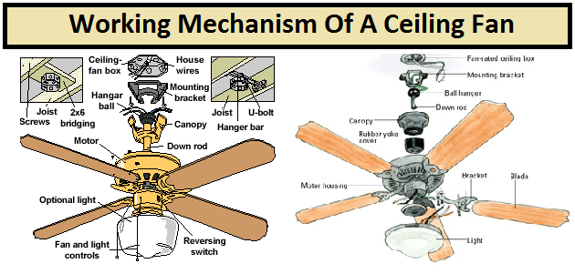
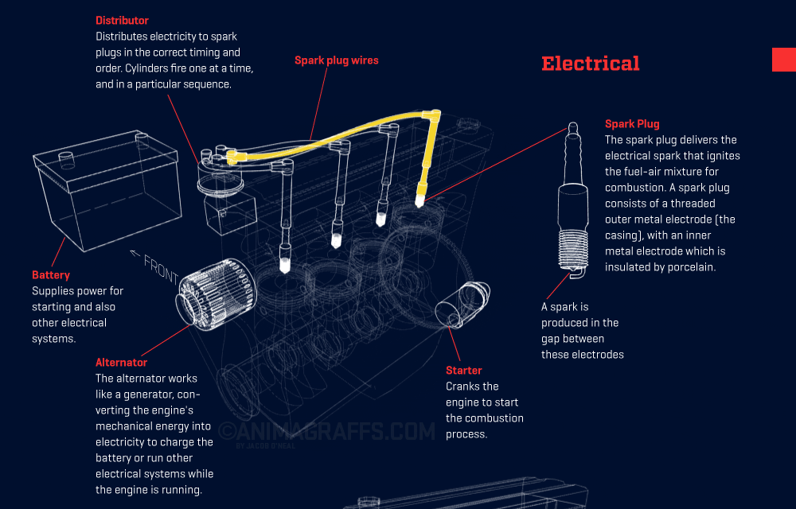
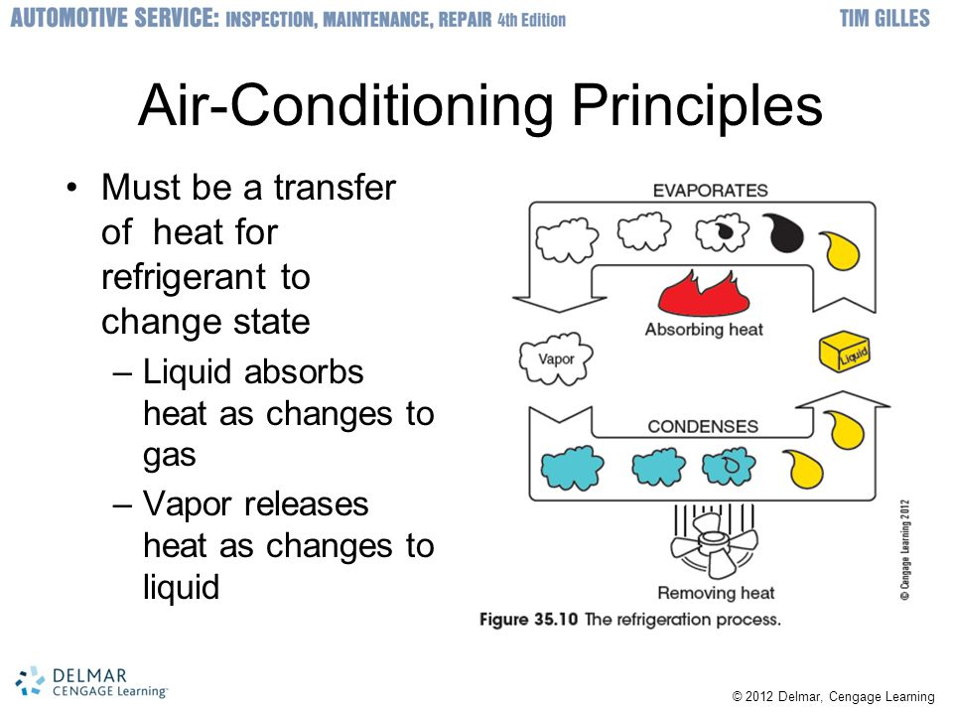
Can we program all machines?
Notes:
Well most of these machines during the earlier part of their invention/innovation were hard-wired or pre-programmed.
However with the advance of technology a lot and most of these machines are programmable to an extent.
Absolutely, we are not going to study how machines work and/or how they can be programmed.
This session is a prelude of how we can program some of the more advanced machines in the later parts of our session(s)

Slide 4
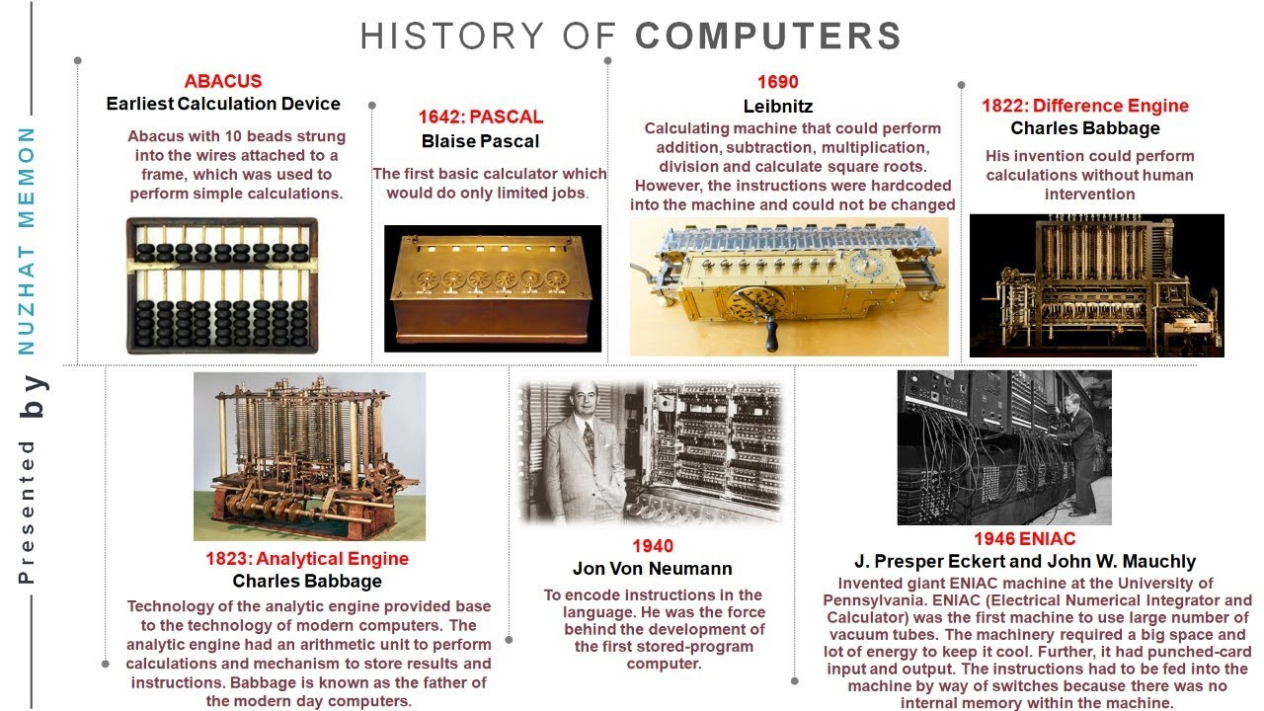
Computing machines
Notes:
Machines that were/are used for sheer computing purposes in various disciplines of sciences like Mathematics, Physics, Chemistry, Astronomy …..
ABACUS - Abundant Beads, Addition & Calculation Utility System
The abacus , also called a counting frame.
First mechanical device used for calculations.
It used to perform basic arithmetic operations.
Invented by Mesopotamians around 3000 BC.
Had beads on movable rods divided in 2 parts.
Used even today by young children to learn basic calculations.
NAPIERS BONES
Invented by John Napier, a Scottish mathematician, in 1617.
The method was based on lattice multiplication.
It has set of rods or bones with multiplication tables on them.
Performed addition, subtraction, multiplication and division.
More advanced use of the rods can even extract square roots.
PASCALINE
Invented by Blaise Pascal, a french Mathematician invented it in 1642 .
Pascaline is also known as the arithmetic machine or Pascal’s calculator.
It could perform ADDITION and SUBTRACTION faster than the Abacus.
The Pascaline Machine consisted of numerous toothed wheels having unique position value.
The rotation wheels controlled the Addition and Subtraction operation.
This Machine was capable carry-transfer automatically.
LEIBNIZ WHEEL
Invented by Gottfried Wilhelm Leibniz in 1685.
Extended Pascal Calculator to have automatic multiplication and division.
This Machine performed multiplication through repeated addition of numbers.
It had a cylinder or stepped drum with a set of teeth of incremental lengths which, was coupled to a counting wheel.
JACQUARD'S LOOM
It was invented by Joseph Marie Jacquard in 1804.
It made the cotton weaving process automatic.
The loom was controlled by a number of punched cards laced together into a continuous sequence.
DIFFERENCE & ANALYTICAL ENGINE
Invented by Charles Babbage in 1822 and 1833.
Difference Engine was expected to calculate logarithmic tables to high degree of precision.
Difference Engine was capable of polynomial evolution by finite difference.
It could solve differential equations and was powered by Steam.
It stored program to perform calculations and print results
Analytical Engine had Input, Output, Store, Mill and Control units
CENSUS MACHINE
It was invented by an American named Herman in 1889.
It was invented to count the population of USA.
Its operation were controlled by punched cards.
MARK 1
It was invented by Howard Aiken in 1944 along with IBM.
It was the largest electromechanical computer.
“MARK-I” could multiply two 10 digit numbers in 5 second-a record at that time.
It could execute computations automatically. It is considered to be the real beginning of the era of the modern computer
John Von Neumann Architecture
In 1945 Dr John Von Neumann proposed the concept of a stored program computer
Program and data could be stored in the same memory unit.
It had 5 Components – Processing Unit, Control unit, Memory, external storage and Input and Output mechanisms.
Check out our video on Evolution of Computers: https://youtu.be/rKjfb9vscVM

Slide 5

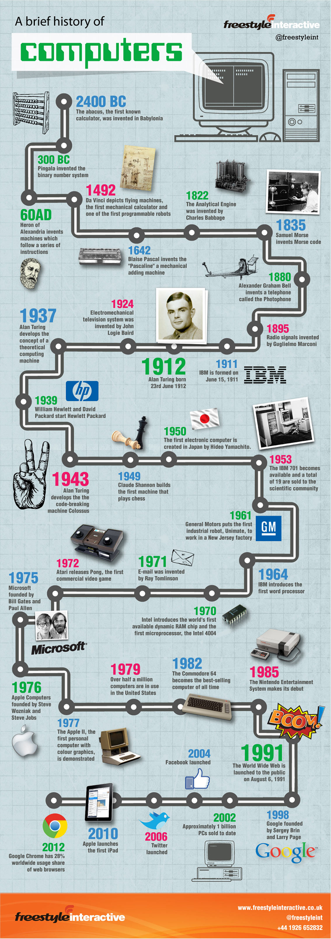
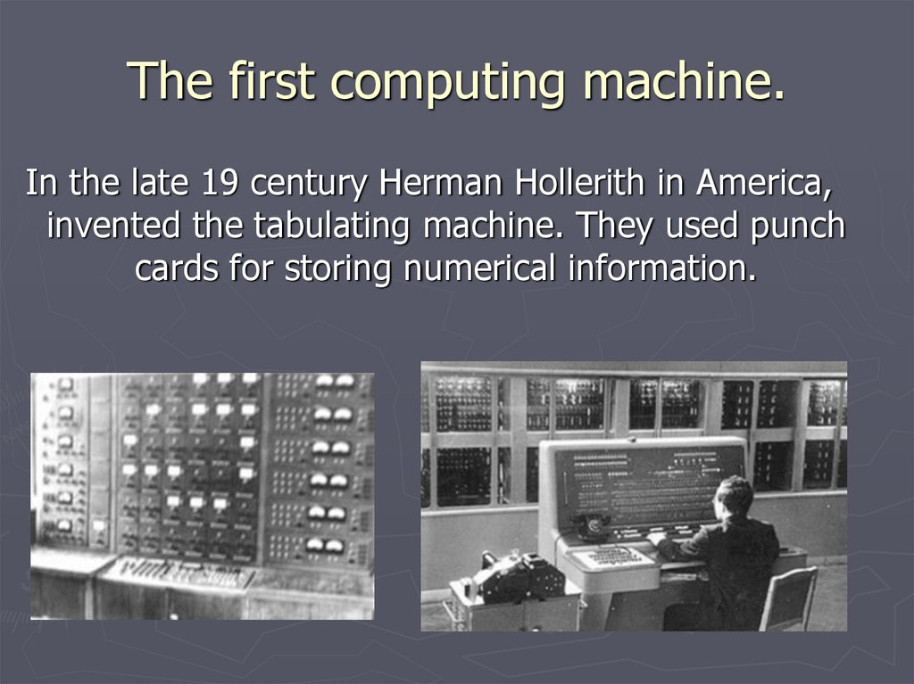
Early Programmable Machines
Notes:
Some of the very early programmable machines were programmed using simple mechanical artifacts like pullies and levers. Like we said earlier one form of energy to another.
While some of the later part of them were built to work on electrical pulses by using the simple technique of input, process and store.
Over a period of time as a part of evolution, these machines have shrunk from the size of a football field to the tip of our finger.
So did their computation power has increased exponentially.

Slide 6
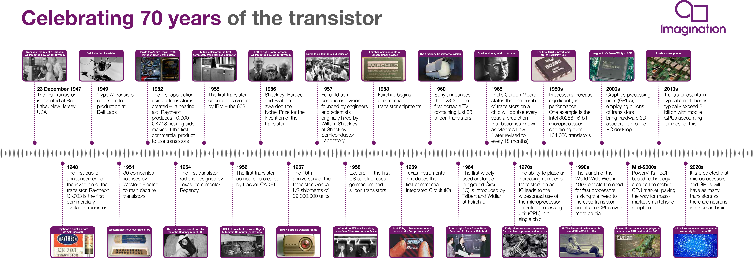
Building blocks

Slide 7
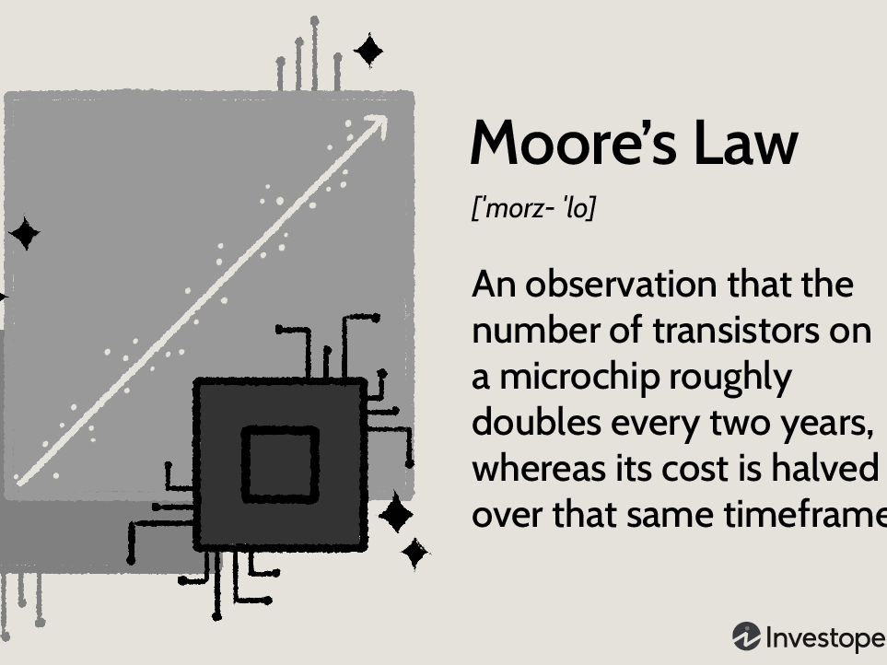
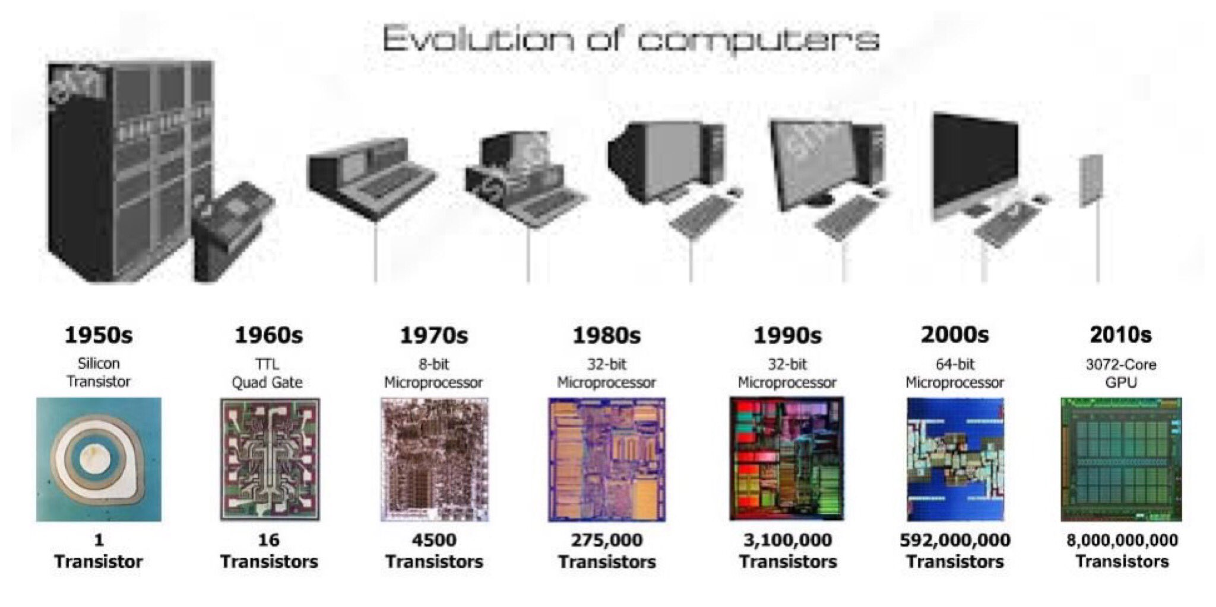

Slide 8
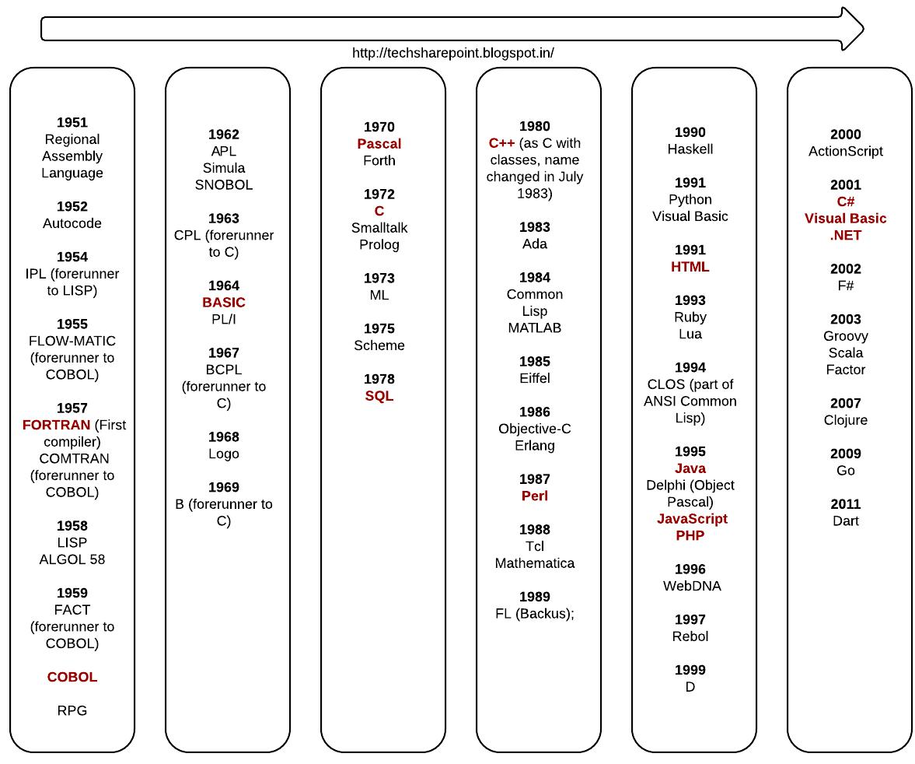
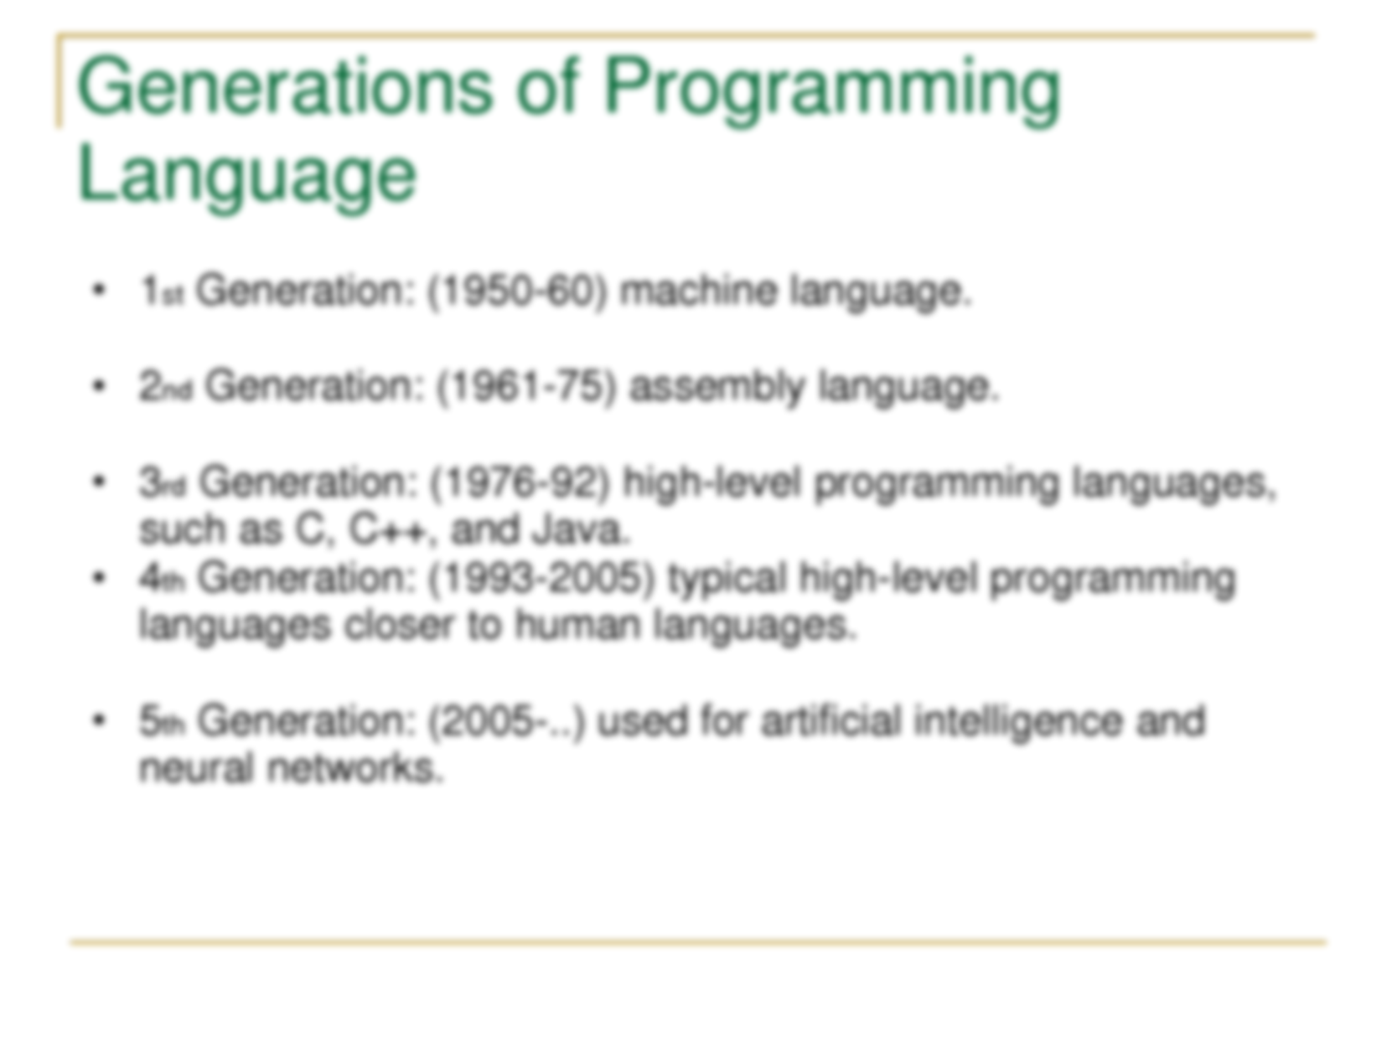
Notes:
Some of the early generation of programming languages were called ‘Machine Language’, because they were directly programmed to the machine either as electric pulses or punch cards and based on these input the machines would process and respond back.
As these machines evolved, so did the programming languages from being machine level to assembly to simple human readable/comprehendible/understandable versions.
It is predicted that machines would evolve to a stage where they would design their own programming languages for a more precise and accurate computation capability.

Slide 9
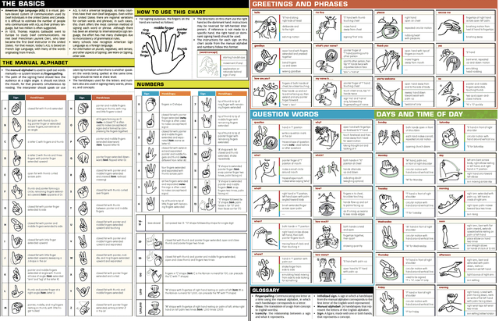
Language Basics
Notes:
Obviously every language has certain basics to be mastered to effectively communicate.
The alphabets, grammar, sentences, phrases, paragraphs ……
Communication is/are expressed differently in different languages while written and spoken.
Well, the same applies to programming languages.

Slide 10
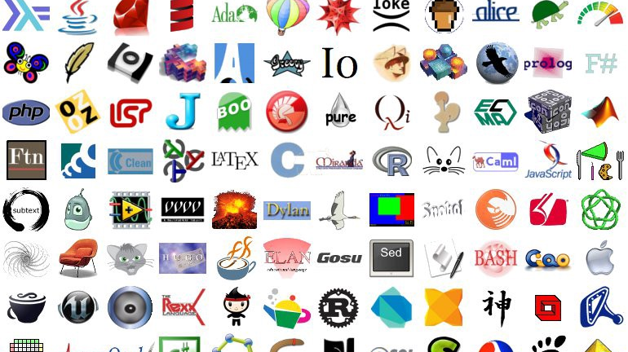

Slide 11
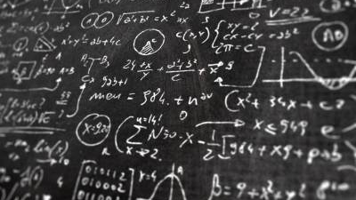
Programming Language Basics

Slide 12
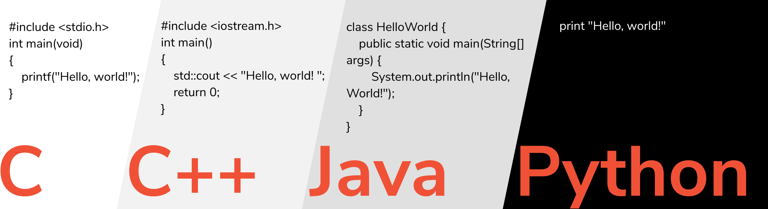
Hello World
Notes:
A Compiler/Interpreter is a language processor to convert the program from a human readable to machine processing format (aka Machine/Binary Language and/or Assembly Language)
While C and C++ are compilers, Java is both a compiler and an Interpreter
However Python is an Interpreter

Slide 13
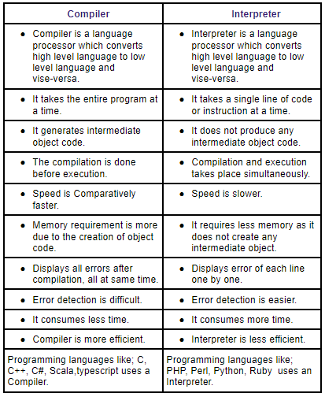
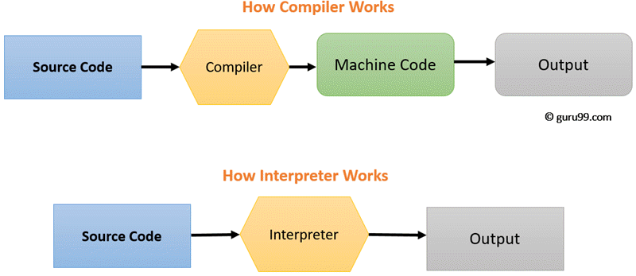
Compilers vs Interpreters

Slide 14
Basic vocabulary
Data-types
Variables
Data Structures
Syntax
Constants
Algorithms
Notes:
The data-types that are supported by the programming language – like integer, float/double (aka decimal), strings (aka character)
The syntax of a programming language – how a programmed is to be written, the declarations, the terminations, the punctuations etc.
Variables – indirect access to memory location on a machine to store, retrieve and process data
Constants – the same as variables, except that the value store cannot modified for the lifetime of a program
Data-structures – the building blocks of a program which help express real world entities in a program, like a person, employee, student, bank account, airline ticket, …….
Algorithms – the steps and procedure to perform a certain activity effectively, like sorting, searching, indexing ……
Please keep in mind that not every programming language have the same level of support for all the above mentioned topics in the same way, each language is meant for a different purpose and so does their support for the above.

Slide 15
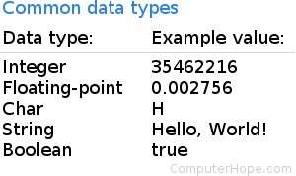
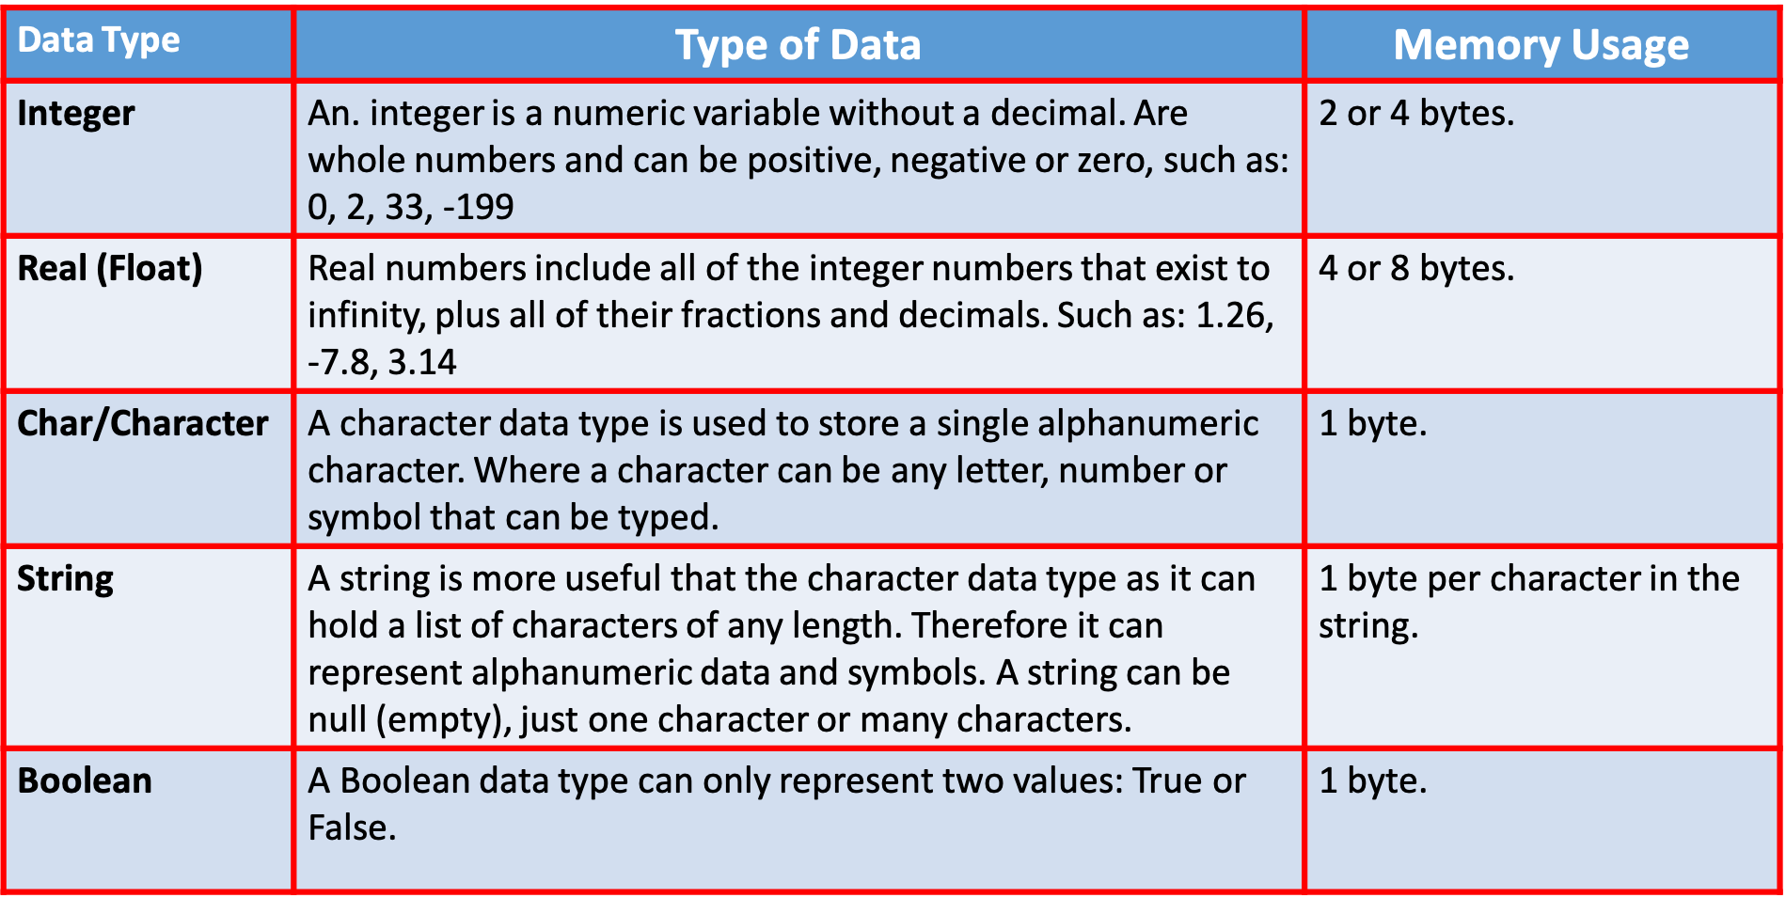
Data Types

Slide 16
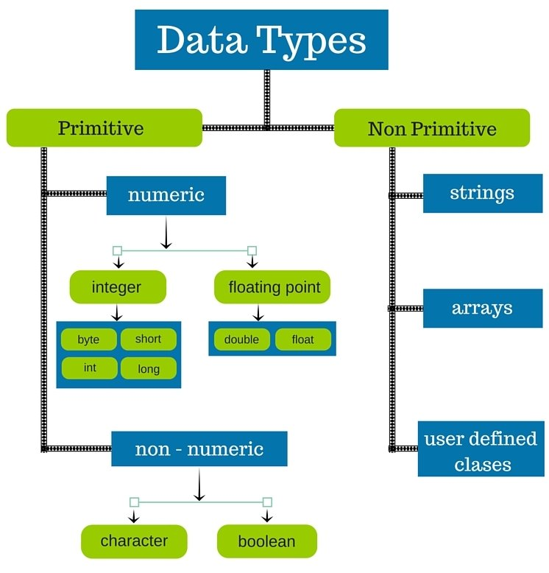
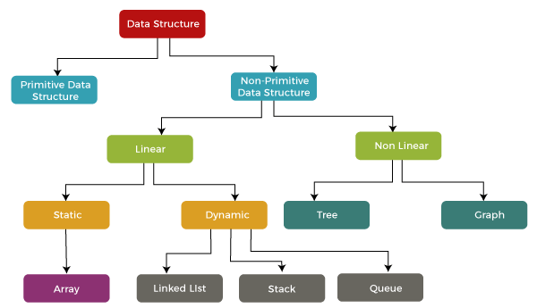
Data Types/Structures

Slide 17
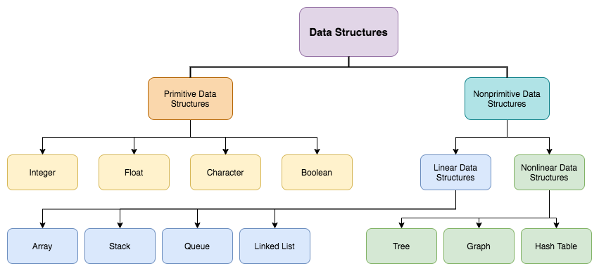
Data Structures

Slide 18
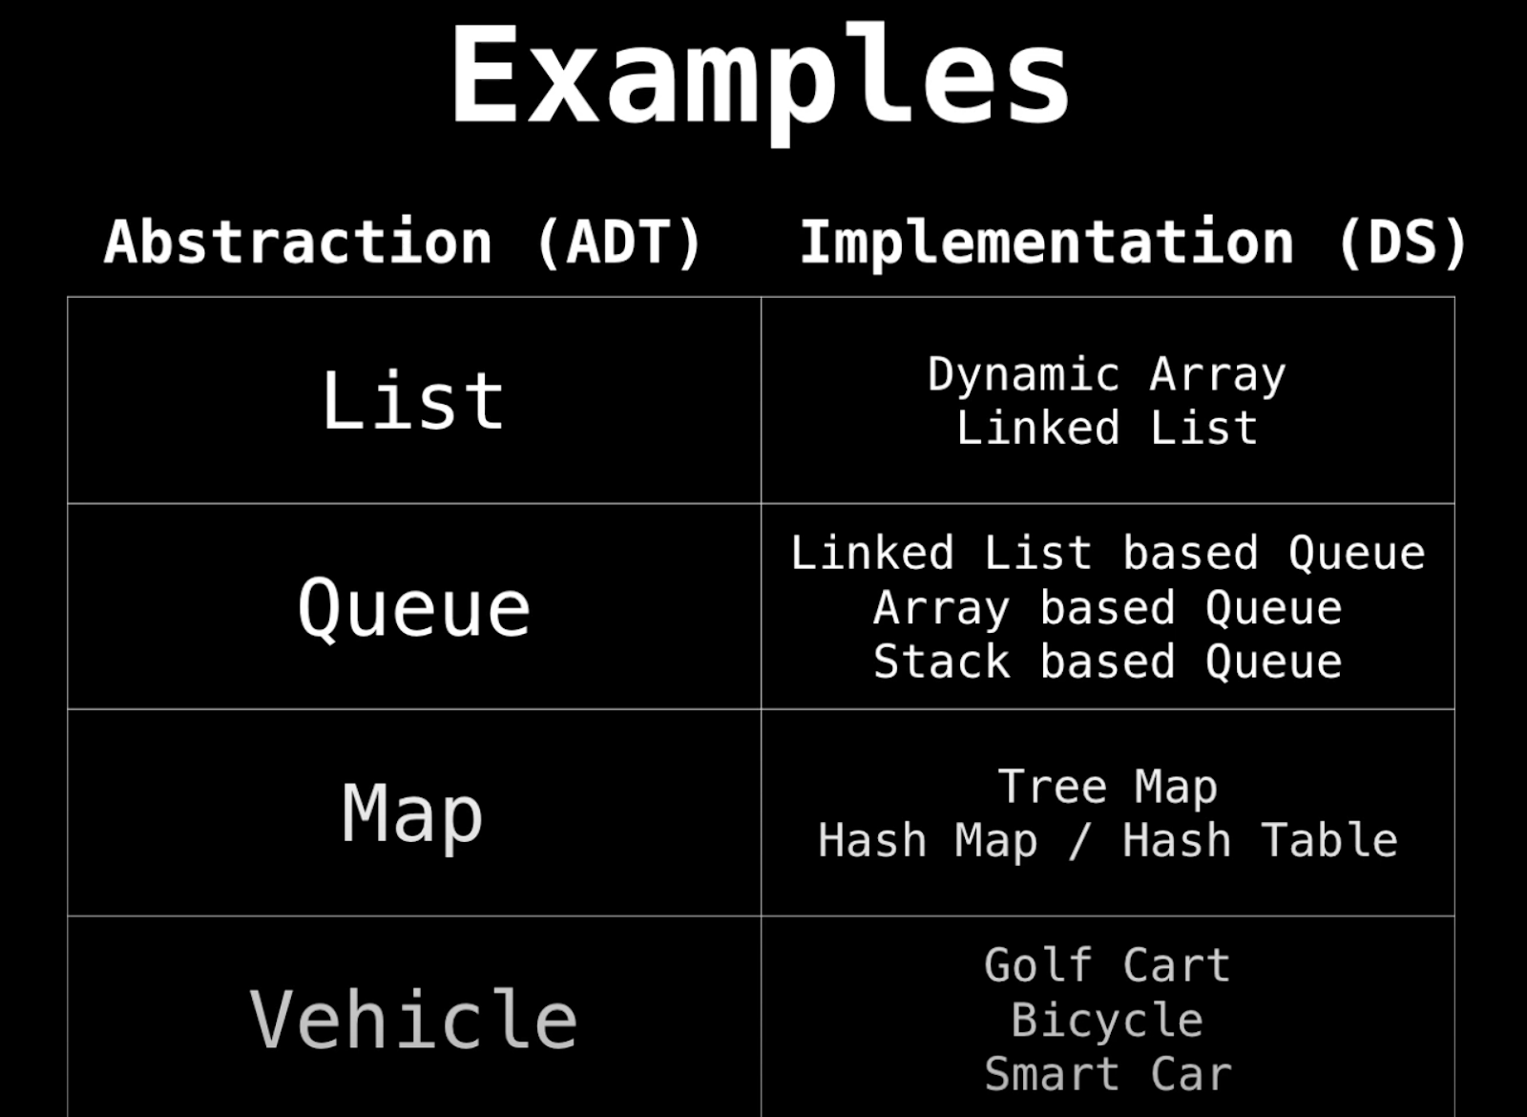
Data Structures

Slide 19
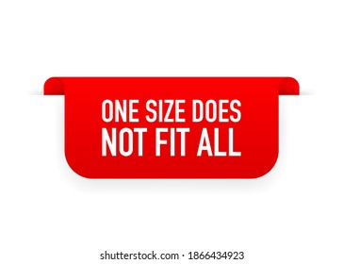
Notes:
Different programming languages provide implementation for each of these before discussed topics differently
Some of the programming languages come pre-fitted, while some give the opportunity to hand-craft them to the need of the problem/solution domain.

Slide 20
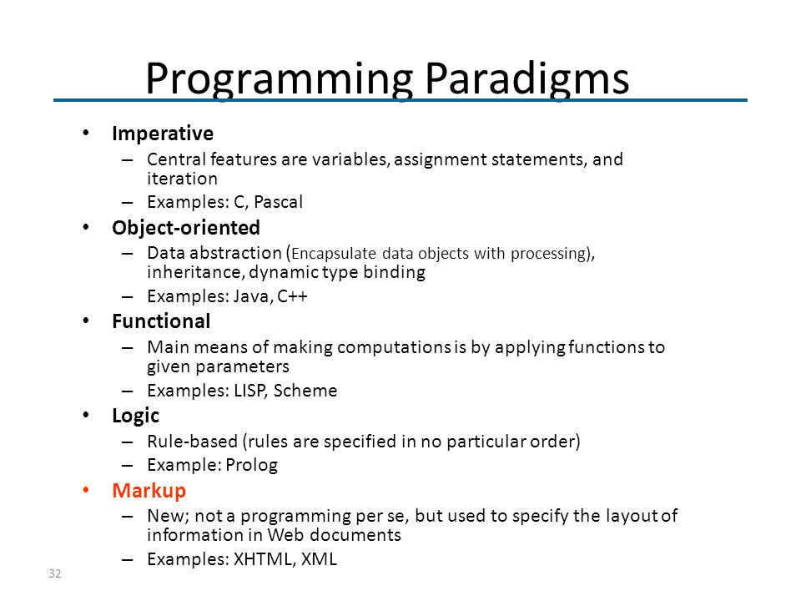

Slide 21
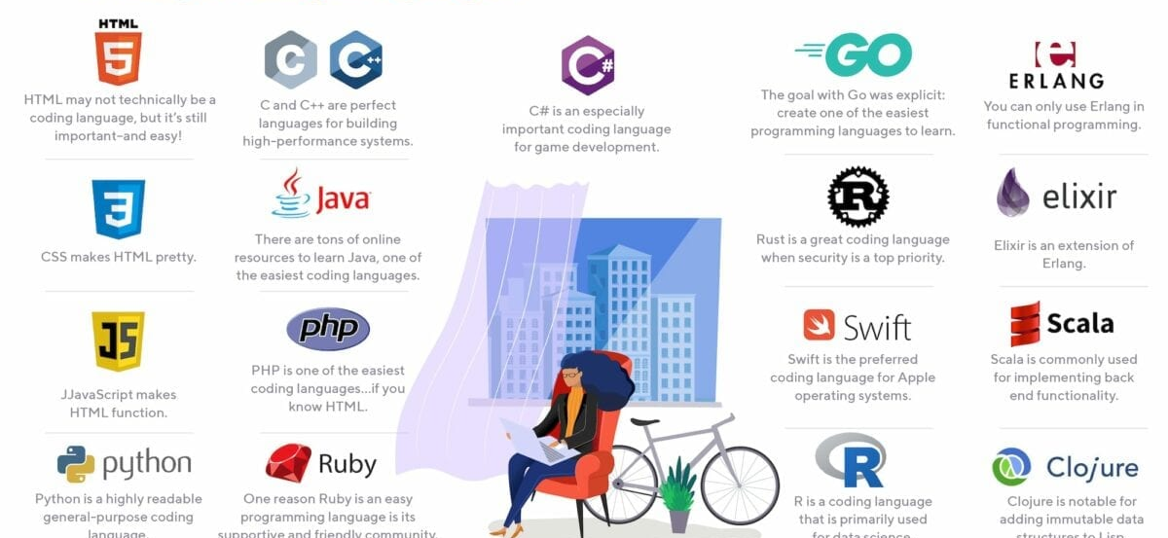

Slide 22
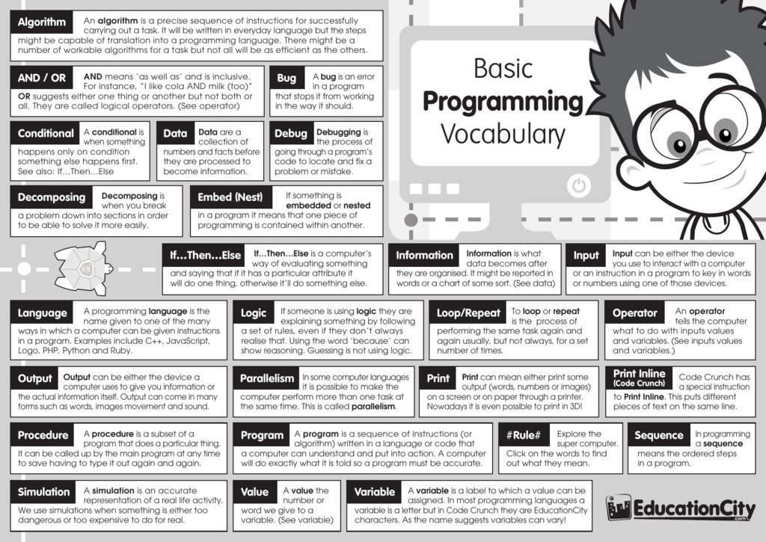
Explore

Slide 23
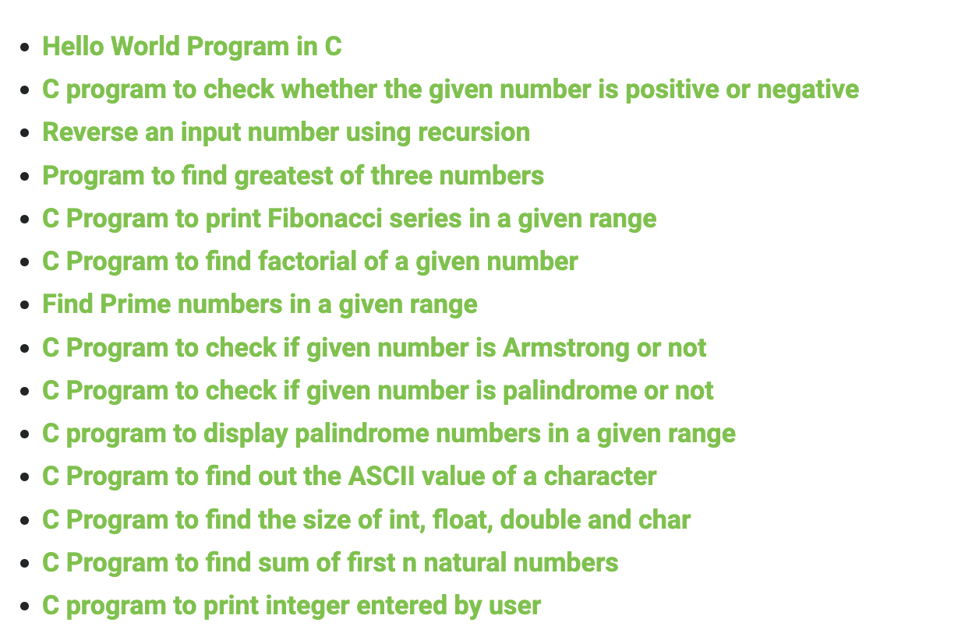
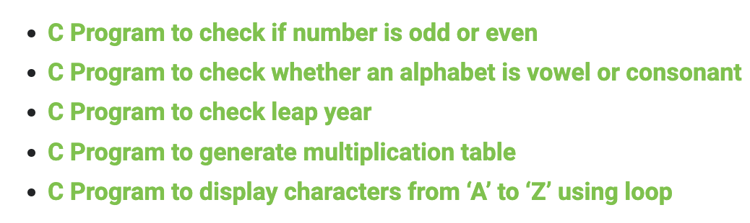
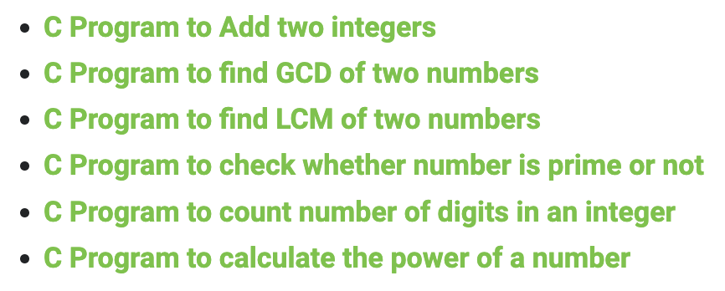
Practice -1

Slide 24
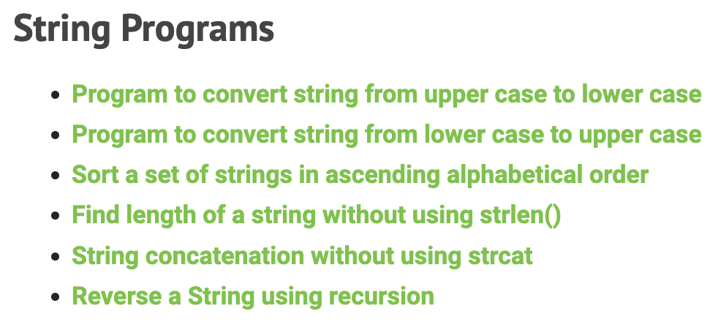
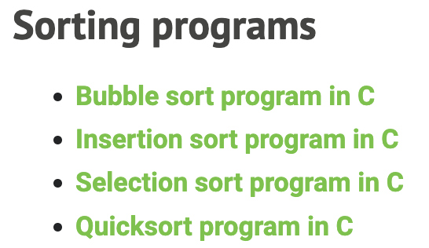
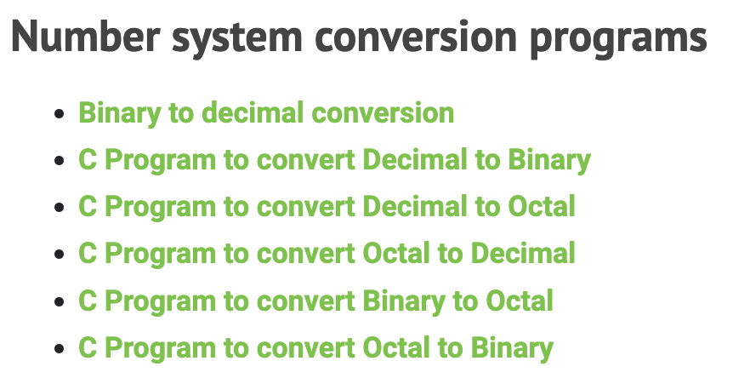
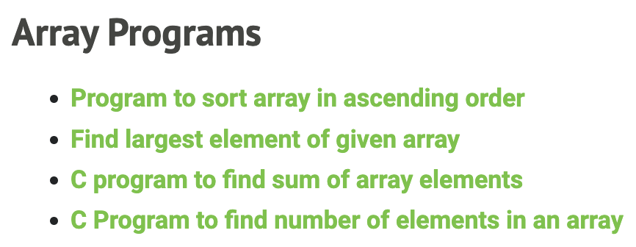
Practice-2

Slide 25
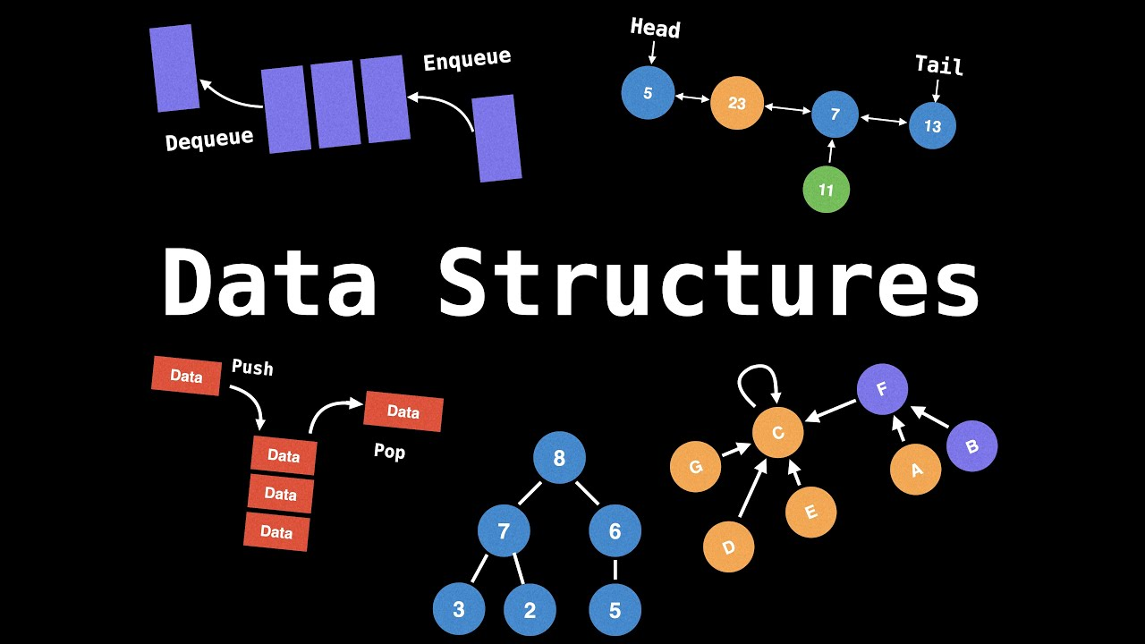

Slide 26
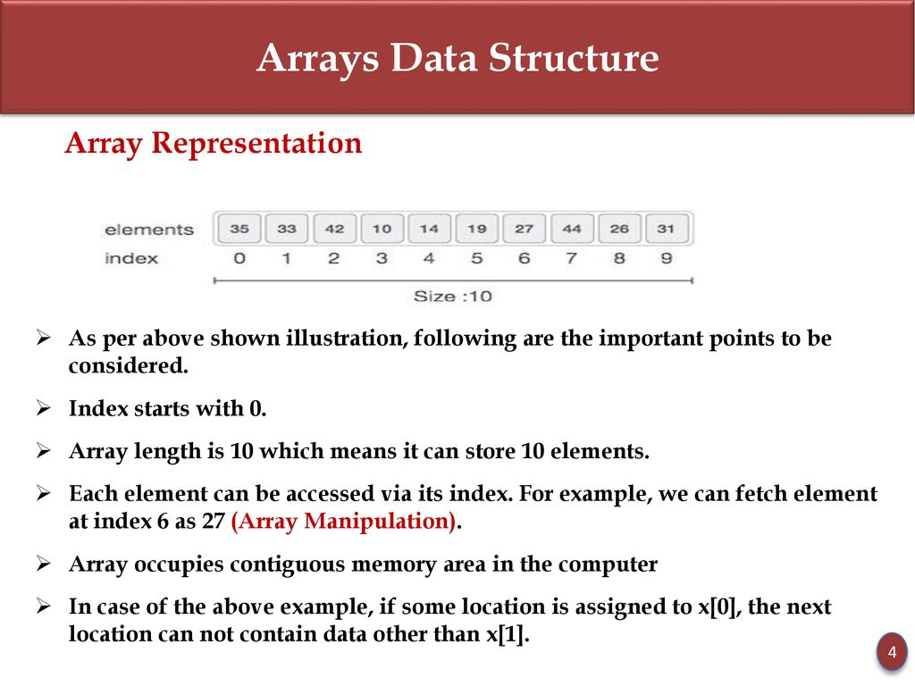
Arrays

Slide 27
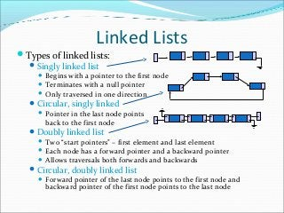
Lists

Slide 28
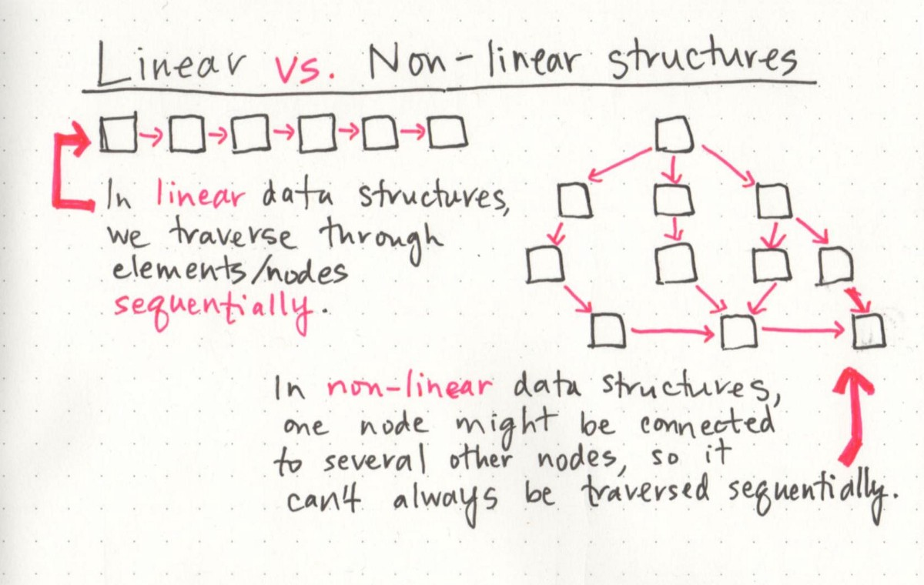
Linear vs Non-Linear Structures

Slide 29
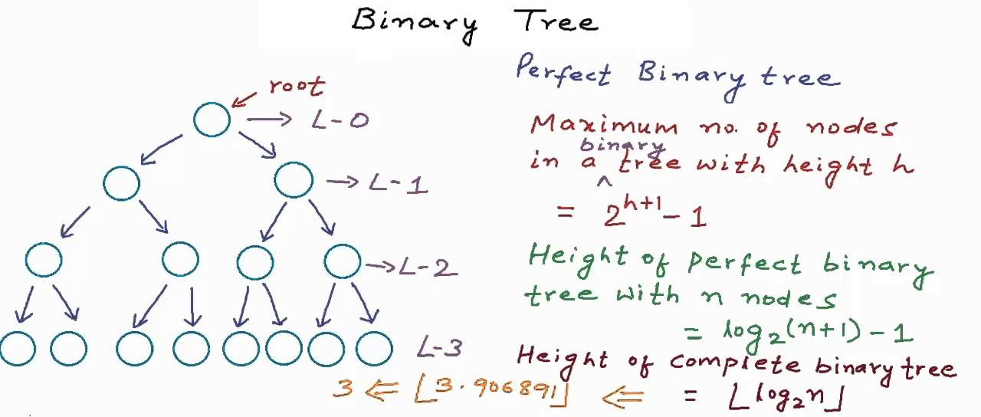
Tree

Slide 30
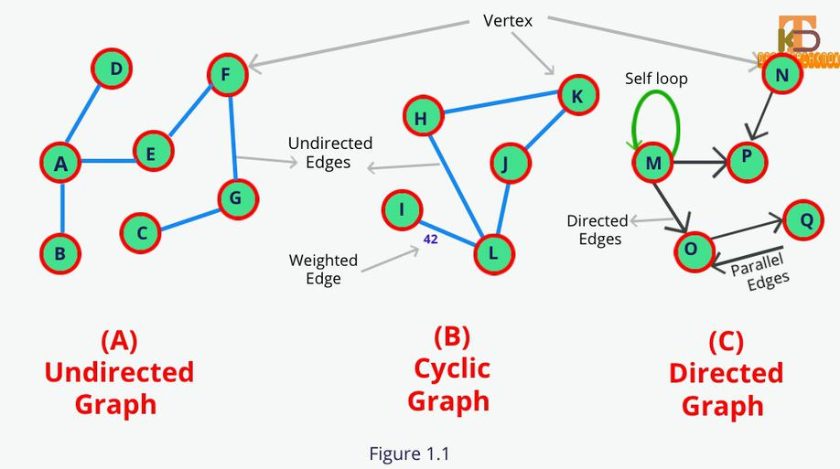
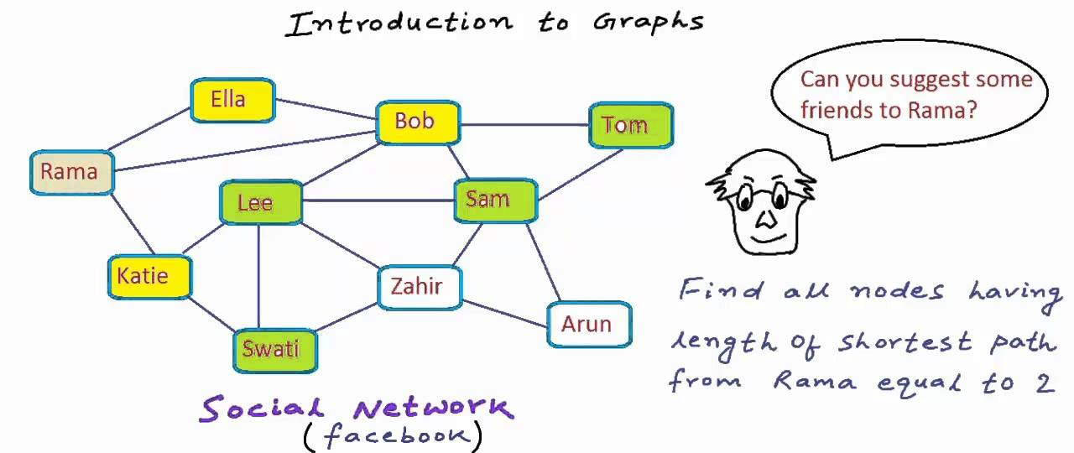
Graph

Slide 31
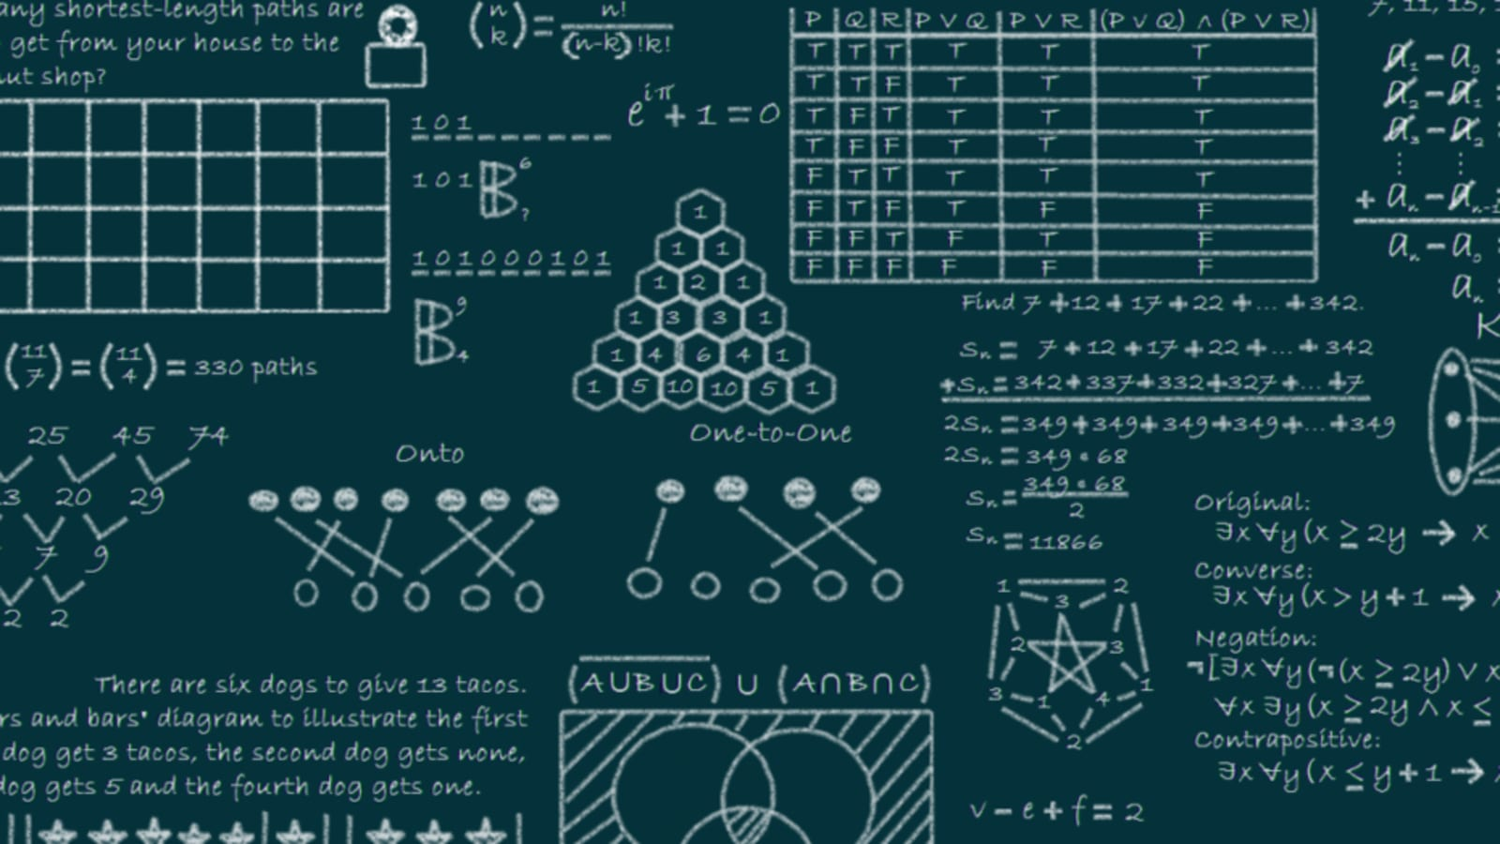
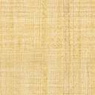
Algorithms

Slide 32

Algos and Data Structures

Slide 33

What is an Algorithm?

Slide 34


Frequently used algorithms

Slide 35

Bubble Sort

Slide 36

Insertion Sort

